Slide 1
Video game recommendation system
By: Matt Wishoff, David Chau, Thomas Tse

Slide 2
(introduction) - The problem
There are no good recommendation systems for video games.
Lots of filters, but no reliable scoring of games.
Star scoring is not entirely accurate.
We aim to provide accurate scoring of games, to better recommend a game. As well as recommending games the user does not already own.

Slide 3
Failed approaches
We wanted to make an Android mobile application.
Problems with Apache Solr, and Indri.
Switched to making a website as our delivery device.
Still having problems with Apache Solr.

Slide 4
Successful Approach
We made a website as our delivery system that accepts simple queries of video game names.
EX: “CounterStrike”
We decided to not use solr in our project and index the data ourselves.
We decided to get most of our data from Steam web pages, instead of APIs.

Slide 5
Getting the data
We tried going to APIs to acquire video game metadata such as GiantBomb, Steam, IGDB, theGamesDB. All the APIs except Steam were useless.
Getting a list of video games from Steam.
Scraping Steam web pages to acquire the HTML metadata.
Indexing the metadata from the HTML that was scraped from the Steam pages.

Slide 6
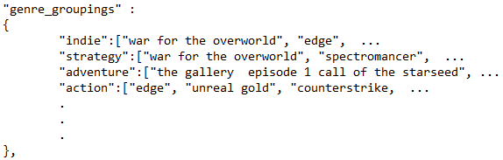
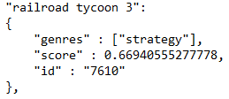
What our indexes look like
Genre Groupings
Hash on genre, points to list
Of games in that genre
Index
Hash on game name, points
To genre, score, and id
Ability to expand our index,
when given a title of a game.

Slide 7
First scoring idea
List of positive and negative words
Count all the positive, and negative words
And find the average to see if the review was
Positive or negative.
Doesn’t work! Lacking context!

Slide 8
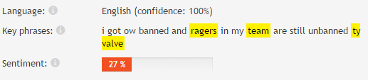
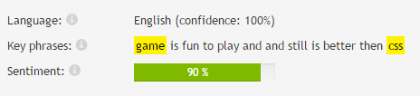
Second scoring idea
We use a Microsoft text analytics API to apply sentiment analysis to the game reviews.
The API returns a value between 0% and 100%
Below 50% is negative sentiment
Above 50% is positive sentiment
Allows us to prescore all of our games before a query.

Slide 9
The query Process
Query such as “CounterStrike”
We search our index for the genre of the game
We search the Genre_Groupings index for games of the same genre
After getting games of a similar genre, we check their scores in the games index.
We return a subset of games that score over 70%

Slide 10
The Query results
We decide to return a set of games over 70% to include variety.
We return ~5 games with 90+ scores
~5 games with scores between 80 – 90
~5 games with scores between 70 – 80
We return one highly correlated game with the rest of the results.

Slide 11
Correlation between games
We gather data about Steam users, ~3600 users.
Make pairings between games of the same genre and save to a hash.
When a game pairing is seen again, we increment a counter in the hash by 1.
Once we reach a threshold of ~1/3 of our users we consider the games correlated.

Slide 12
irrelevant results
We only return games of the same genre(s).
If provided the users Steam ID with the query, we’re able to filter out games that the user already owns.

Slide 13
Query feedback
When we return a list of games, we know if one of the results are clicked and keep a count of how many times the result is clicked.
However we were unsure of how to incorporate the feedback into our recommendation algorithm in a good way.

Slide 14
Adding new games to our index
Given the id of a game, we can add it to our index directly on our website.
After adding it, you can go ahead and query it, and get recommendations for that game.

Slide 15
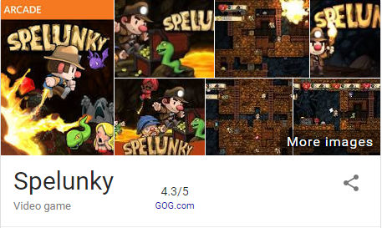
Comparing to other scores
Comparing the star rating given by various sources, to our rating we’ve given the games.
Spelunky ~ 4.3/5 stars, we rated it 0.77

Slide 16


Comparing to other scores
Cities: Skylines ~ 4/5 stars, we rated it 0.76
Counter-Strike: Condition Zero ~ 4.5/5 stars, we rated it 0.84

Slide 17


Comparing to other scores
Railroad Tycoon 3 ~ 3.5/5 stars, we rated it 0.67
Counter-Strike: Global Offensive ~ 4.5/5 stars we rated it 0.52

Slide 18
User Testing
We tested our recommendation system on some of our friends.
They were all able to find games they were interested in.
Shane queried “Doom ii”, selected “Broforce” from results
Trent queried “Off world trading company”, selected “Rome total war alexander” from results
Emil queried “Dota 2”, selected “Waking Mars” from results

Slide 19
Conclusions
If we have enough reviews we are able to give an accurate score of a game.
TF.IDF is not the only way to score games.
Finding highly correlated games is an excellent way to recommend games.
User data is the key to give more accurate recommendations.

Slide 20
Future work
Expanding our index to include more reviews for better accuracy.
Expanding our index of games so that we can better recommend a variety of games.
Include the user feedback into our recommendation algorithm instead of just collecting it.
When a user puts in their user ID we could index the games not in our system already.

